Slide 1

David Miller – Executive Director
February 2026
FAIR TRADING COMMISSION
Promoting competitive markets
ESTABLISHING EFFECTIVE COMPETITION AUTHORITIES: THE JFTC EXPERIENCE

Slide 2

OUTLINE
Jamaica Fair Trading Commission
Benefits of Competition Law
Main Pillars of Competition Policy
Main Functions of Competition Agencies
Institutional Design
Overall Agency Effectiveness

Slide 3
The Jamaica Fair Trading Commission
Jamaica’s Competition Authority – created by the Fair Competition Act (1993)
Consumer Protection matters – 1993 to 2005
Competition matters - robust enforcement

Slide 4
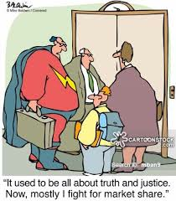

Slide 5
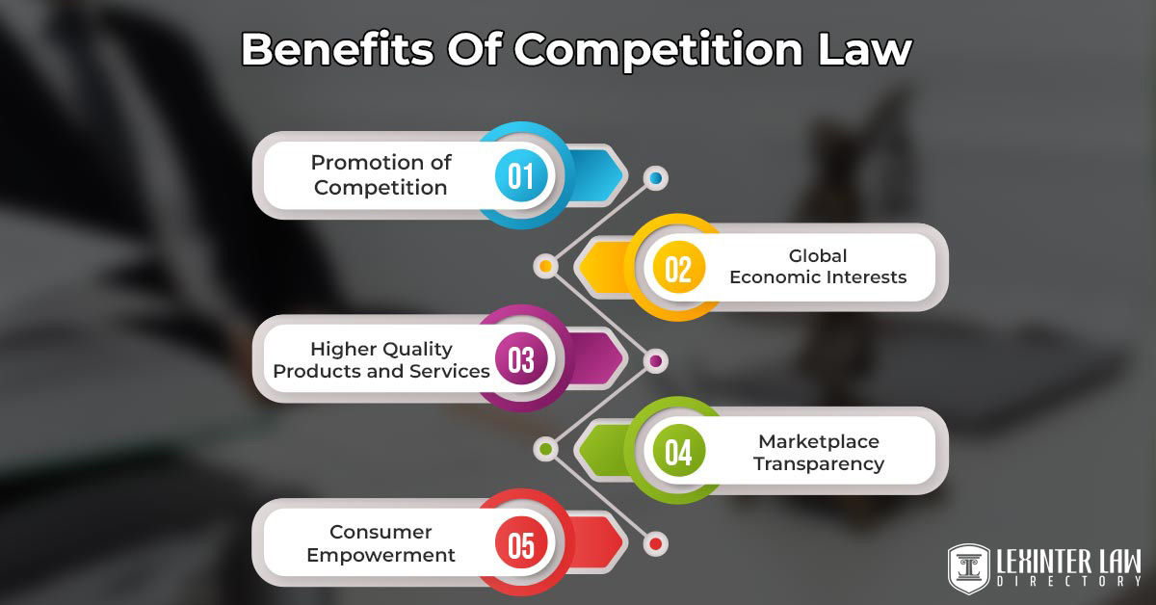

Slide 6

BENEFITS OF COMPETITION LAW
Competition provides the proper incentives for merchants to offer consumers quality products at the most affordable prices
Under competitively organized markets
  Prices are lower
  Output is higher
  Product choice is greater
  Rate of technical innovation is higher, relative to markets which are not competitively organized

Slide 7
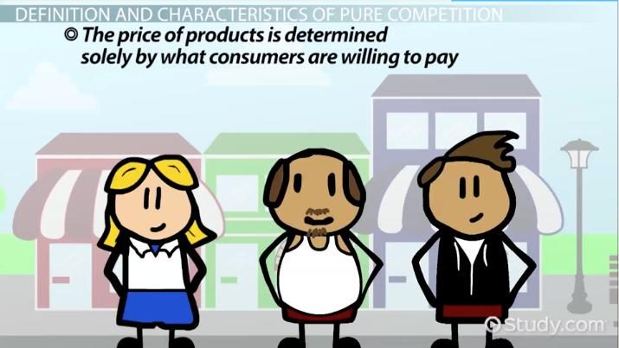

Slide 8
MAIN PILLARS OF COMPETITION POLICY
Abuse of Dominance
Collusive Agreements
Mergers & Acquisitions

Slide 9
MAIN FUNCTIONS OF COMPETITION AGENCIES
Enforcement
Advocacy
Public Education

Slide 10

INSTITUTIONAL DESIGN
Operations
Legal Framework
Internal Processes & Procedures
Investigative Process
Decision Making
Necessary Characteristics
Cooperation
Institutional Memory
Sound Infrastructure

Slide 11
TAGLINES
Country | Tagline
Australia | Be fair & competitive
Botswana | Fair markets, empowered consumers
Colombia & UNCTAD | Prosperity for all
Gambia | Leveling the field for development
India | Fair competition for greater good
Pakistan | Creating a level playing field
Poland | We are about consumers, entrepreneurs & free market
South Africa | A growing, deconcentrated & inclusive economy
UK | Making markets work
US FTC | Protecting America’s consumers

Slide 12
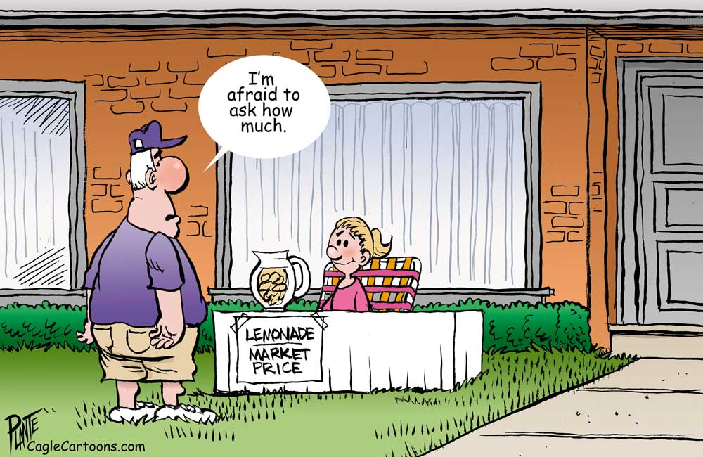

Slide 13
Agency Operations
  Administrative, Legal & Economics Departments
    Investigations
    Market studies
    Competition advocacy
    Public education
    Staffing
    ICT
  Budget & Financing
  Adherence to Procedures, Processes, Guidelines

Slide 14

Legal Framework
Legislation
  Provisions that properly define the scope & effect of the policy
  Institution with administrative and investigative responsibilities
  Oversight Board responsible for administration and policy direction – separate from Staff, to prevent regulatory capture.
  Tribunal or Hearing Structure
Treaty Obligations

Slide 15
Internal Procedures, Processes & Guidelines
Management
Accounting
Investigative
Research
Clearly Defined
PROCEDURAL FAIRNESS

Slide 16

Investigative Process
Case Selection – prioritizing cases
Clearly Defined
Thorough
Separation of Investigative & Adjudicative Functions
- in legislation
- in procedures and processes

Slide 17
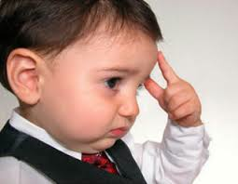
Decision Making
  1 person
  Commissioners or Tribunal: Collegial
  Court
Required Skills: Legal, Economics, Management,
Business operations

Slide 18
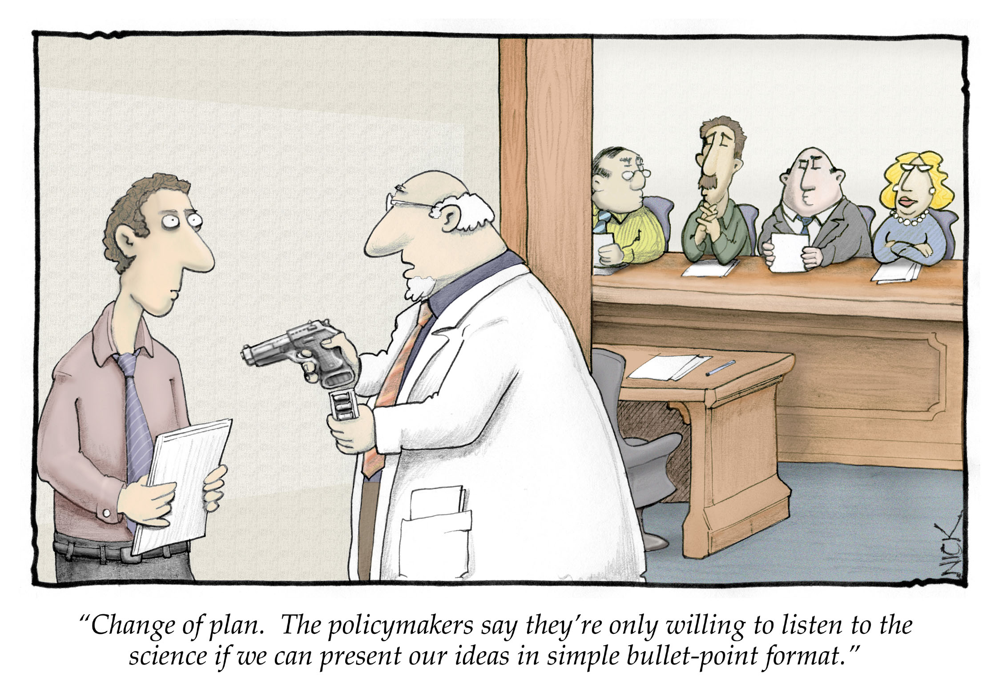

Slide 19
Necessary Characteristics for Competition Agencies
Accessible
Accountable
Accessible
Adequate Powers
Confidentiality
Consistent
Communicate
Credible
Effective
Fair
Independent
Information Exchange
Integrity
Objective
Real
Relevant
Strategic Planning
Team Work
Timely
Transparent

Slide 20

Cooperation & Collaboration Mechanisms
  Other Competition Agencies
  Sector Regulators
  Other Ministries, Departments & Agencies
  Stakeholders
  Cooperation Agreements/MOUs

Slide 21
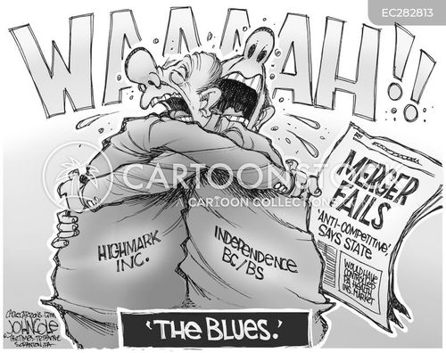

Slide 22

Decisions
  Quality
  Proper
  Monitored
  Adequate
  Deterrence effect
  Effective

Slide 23
Overall Agency Effectiveness
Key Features
Institutional design
Implementation of sound policies & strategies
Capacity building
Knowledge retention
Technological advancements
Culture of Periodic Assessment
Collaboration with MDAs

Slide 24
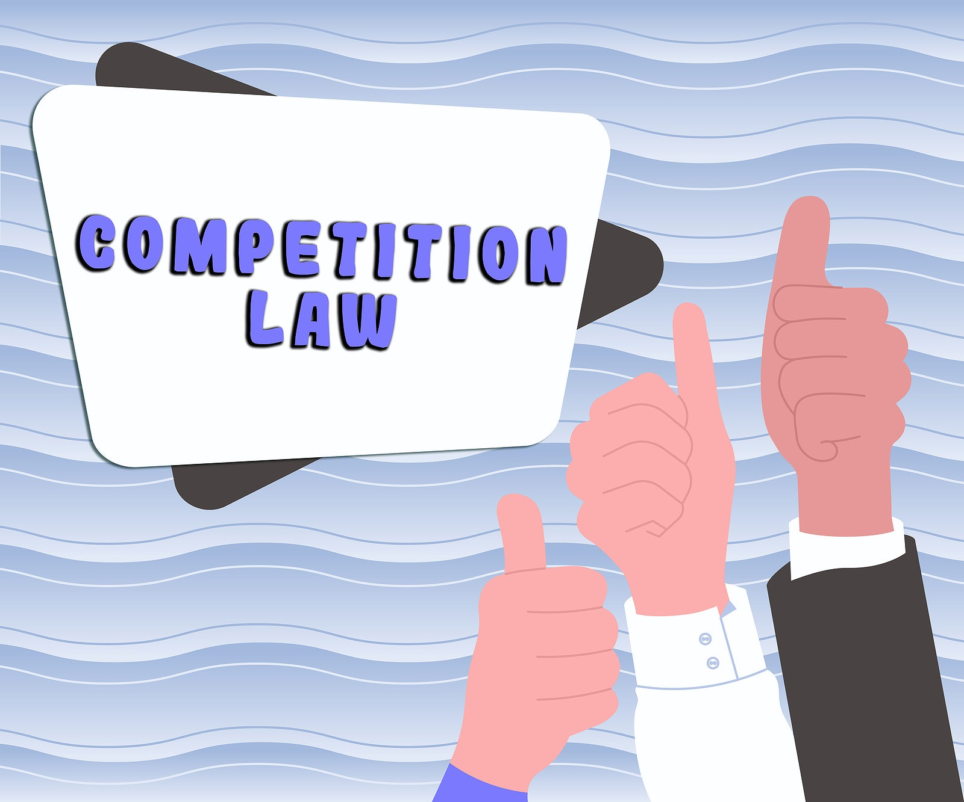

Slide 25
Thank you
Promoting competitive markets
Fair Trading Commission
17-19 Connolley Avenue
Kingston 4, Jamaica
Email: ftc@cwjamaica.com
Website: jftc.gov.jm
www.facebook.com/ftc.jamaica

